Slide 1
JS Core Module Goals
4 months intensive JavaScript development training
5 times weekly, lots of live coding, homework and projects
Part I – JS Fundamentals
JS programming, functions, arrays, strings, objects, JSON, …
Part II – JS Advanced
jQuery, DOM, object composition, classes, modules, unit testing
Part III – JS Apps
REST, AJAX, promises, MVC, ReactJS, routing, building SPA

Slide 2
JS Core Module at SoftUni – Timeline
19-Sep-2016
17-Oct-2016
14-Nov-2016
11-Dec-2016
23-Dec-2016
JavaScript
Fundamentals
Lessons + exercises + team work project + exam
4 weeks * 5 times / week
9 credits
Start: 19-Sept-2016
Final exam: 16-Oct-2016
JavaScript Advanced
Lessons + exercises + exam
4 weeks * 5 times / week
9 credits
Start: 17-Oct-2016
Final exam: 13-Nov-2016
JavaScript Applications
Lessons + exercises + team work project + exam
4 weeks * 5 times / week
9 credits
Start: 14-Nov-2016
Final exam: 11-Dec-2016
Re-Take Exams
3 exams @ one week
16-Dec
19-Dec
22-Dec
Christmas Holidays
2 weeks holiday

Slide 3
Professions @ SoftUni
Java
Fund.
Java
DB
Java
Web
Programming Basics
C#
Fund.
C#
DB
C#
Web
Tech Module
JS Core Module
MEAN
Stack
Web
Basics
PHP
Fund.
PHP
Web
Web
Basics
https://softuni.bg/curriculum
https://softuni.bg/trainings/courses

Slide 4



JavaScript Fundamentals
Fundamentals
Course Objectives & Program

Slide 5

Course Objectives
The JavaScript Fundamentals course provides
Basic coding skills for the JS language
Establishes fundamentals for further JS trainings
Content: JS syntax, data, arrays, objects, functions
What is NOT covered?
Object-oriented programming (OOP) in JS
DOM manipulation, JS libraries and frameworks (AJAX, jQuery, AngularJS, ReactJS)

Slide 6

Course Topics
JS intro, JS syntax, data types, expressions
Operators, conditional statements, loops
Functions and arrow functions (lambda)
Arrays and multi-dimensional arrays
Strings and regular expressions
Objects, JSON, associative arrays
Sets and maps, destructuring
Canvas 2D + DOM and events

Slide 7

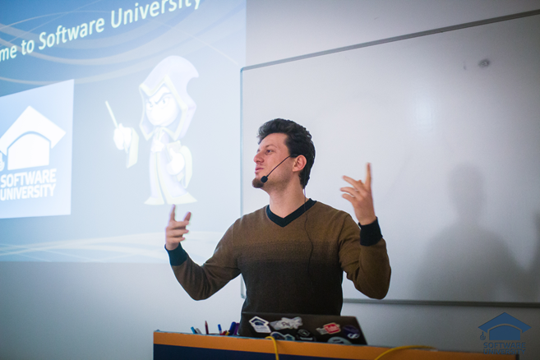
Training Duration and Schedule
Lessons: ~ 20 hours (onsite + YouTube videos)
Practical exercises (in class): ~ 40 hours
Homework: ~ 0-50 hours
Teamwork: ~ 20 hours
Teamwork defense: 0.5 hours
Time frame
19-Sept-2016 – 16-Oct-2016

Slide 8
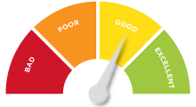

Scoring System for the Course
Mandatory:
Final exam – 85%
Exercises & homework – 15%
Bonuses:
Teamwork – bonus up to 10%
Presence in class – 5% bonus
Forum activity – bonus up to 5%

Slide 9


Homework Assignments & Exercises
Your homework is mainly work in class!
Lesson days → slides + live demos + exercises
Exercise days → only exercises
How to submit your homework?
Submitted in the judge system
Homework assignments are due in 5 days
Due for both lesson days and exercise days

Slide 10

Teamwork Project
Build a team of 3-6 persons
Choose your teammates
Develop a practical project
Choose from existing projects
Or work on your own idea
Public defense
Demonstrate your work live at SoftUni

Slide 11



Course Web Site, Forum and FB Group
Official web site:
Official discussion forum:
Official Facebook group:
softuni.bg/courses/javascript-fundamentals
softuni.bg/forum/categories/12
fb.com/groups/jscoresept2016

Slide 12



Recommended Software
Software needed for this course:
Noje.js – https://nodejs.org
WebStorm – https://jetbrains.com/webstorm/
Optionally:
Visual Studio – https://www.visualstudio.com

Slide 13
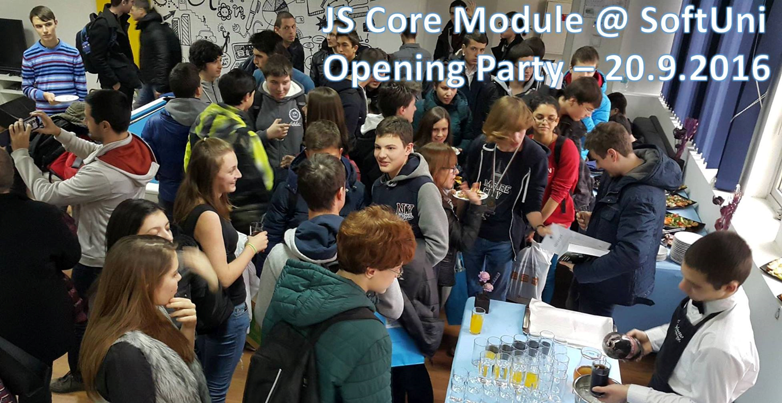
JS Core Opening Party

